Slide 1










Week 4 MileStone:
🎯 Project Title: Smart Event Booking Platform With AI
Team Members
Tech Stack
Amisha Pandey
Seema Kumari
Surayya
Saurabh
Vamsi
EVENTMATE AI PLANNERAND SCHEDULER
FrontEnd : Reactjs and CSS
BackEnd : Java Spring Boot
DataBase : MySQL
Version Control : Git & Github

Slide 2
PROJECT OVERVIEW
Smart Event Booking Platform is a web-based solution that allows users to explore, book, and manage event venues easily.
It integrates AI-driven recommendations, chatbot support, and admin monitoring features.
The platform supports a wide range of event categories, including:
💍 Weddings 🎉 Birthdays
🎵 Concerts 💼 Corporate Events
Additionally, it offers admin monitoring and analytics tools to efficiently manage venues, bookings, and customer interactions — making it a complete, modern solution for event management.
The system works in three main phases:
Registered User Dashboard (after login)
Normal User (without login)
Admin Panel

Slide 3








KEY FEATURES
AI-powered recommendations
Hall booking with filters
Suggests venues based on user behavior and searches.
Helps users quickly find the most relevant halls.
Users can filter halls by location, price, capacity, or event type.
Makes booking faster and more personalized.
Automated chatbot for support
Responsive UI and real-time updates
Works smoothly.
Updates reflect instantly for better user experience.
AI chatbot answers user queries instantly.
Provides 24/7 real-time assistance without human support.
Multi-role system (User, Admin)
Separate dashboards for User and Admin.
Admin manages halls and bookings; users book and explore.

Slide 4












User Layer
(Frontend): React-based UI for users.
SYSTEM ARCHITECTURE
Application Layer
The platform works in three layers:
(Backend): API handling booking and AI logic.
Technical Implementation
1Generated unique API key from NVIDIA:nemotron nano 9B V2 model
Integrated with chatbot request handlers
4.
Admin Layer
Secure monitoring and management dashboard.

Slide 5
NORMAL USER (WITHOUT LOGIN)
Purpose: Allow any visitor to explore venues and interact with the system without registration.
Home Page
Header: Background image with search bar for event search.
About Us Page:
Trending Venues: Auto left-scrolling list of popular venues.
Features
Our Mission
Find by Category: Weddings , Corporate , Birthdays ,Concerts
Personalized Recommendations:AI-driven suggestions based on user behavior and interactions.
Footer Section: Quick links, social icons, newsletter subscription.
Contact Us
Login
SignUp
contact details.
User Login
Owner SignUp
contact form
Owner Login
User Signup

Slide 6
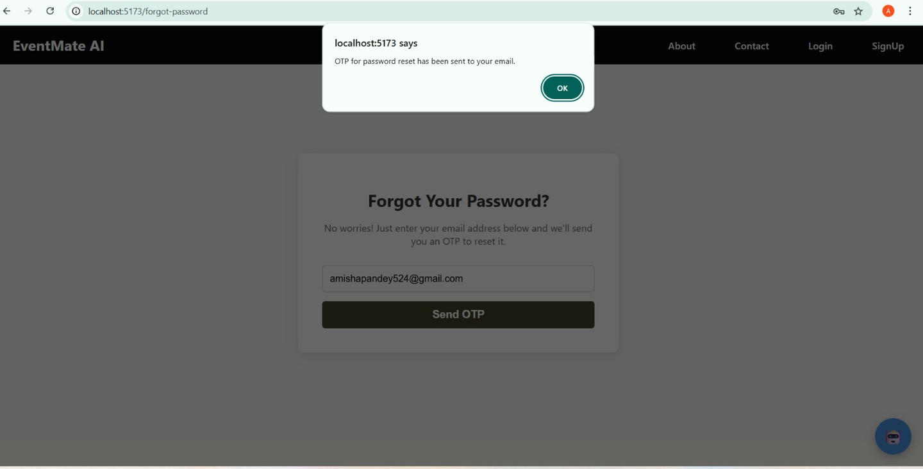
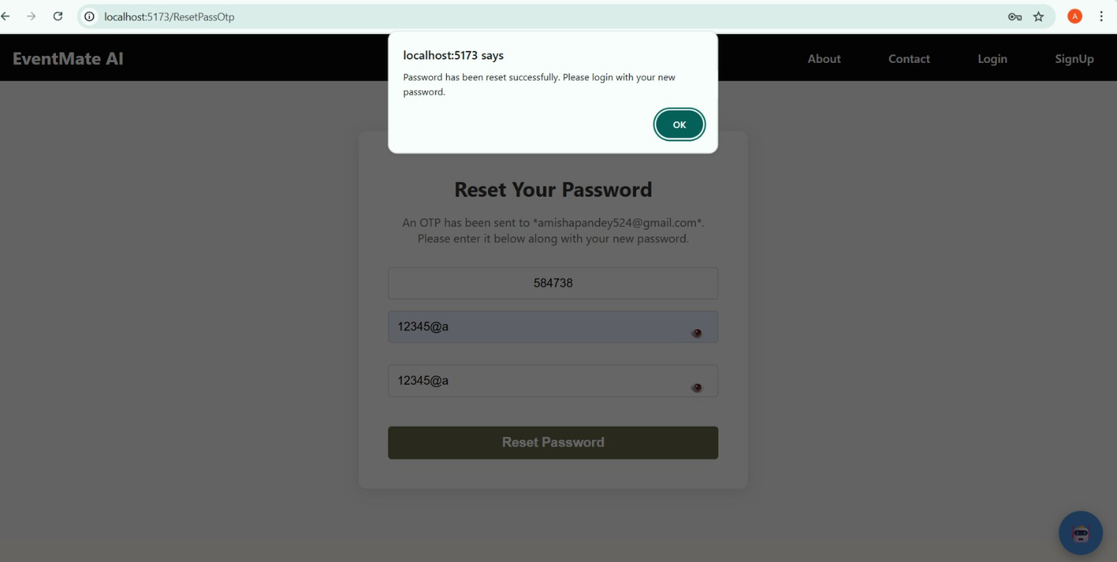
SECURE PASSWORD RECOVERY WORKFLOW
A streamlined, two-step process for secure account recovery, beginning with email OTP verification and concluding with a new password confirmation.

Slide 7
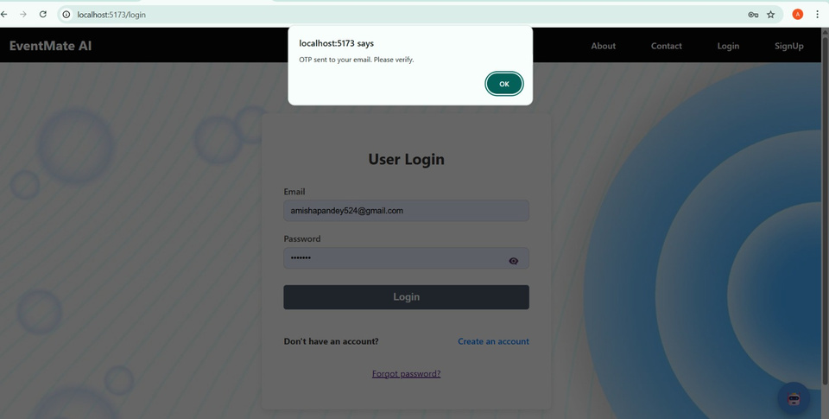
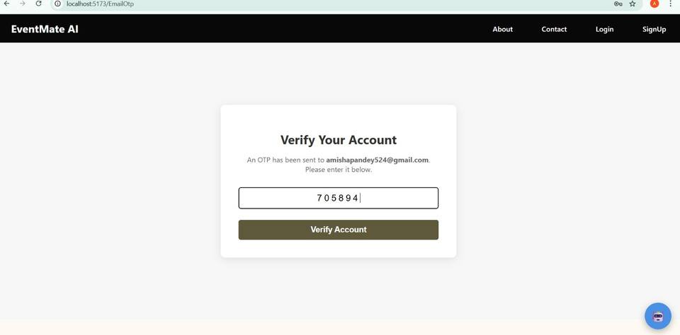

AUTHENTICATION FLOW
4.

Slide 8
REGISTERED USER DASHBOARD (AFTER LOGIN)
Dashboard Options:
Hall Booking:Users can search and book halls with filters (location, price, capacity, etc.).
Photographers:Allows users to find and hire photographers.
Planners:Event planners for decoration and overall event managements.
Cake Section:Order cakes for events.
Attire Section:View and order event attire (wedding dress, suits, etc.).
Booking Feature & Steps:
1️⃣ Find Hall:
User clicks on the “Find Hall” page to explore available venues.
2️⃣ Select Hall:
User selects a preferred hall and clicks on “Check Availability.”
3️⃣ Choose Date & Time:
User picks event date and time.
If the hall is already booked, a message appears with suggested alternative halls.
If available, it proceeds to the next step.
4️⃣ Fill Booking Details:
A form opens to enter Name and Phone Number for booking confirmation.
5️⃣ Booking Confirmation:
After clicking the “Book” button, the system shows a “Booking Successful” message.

Slide 9
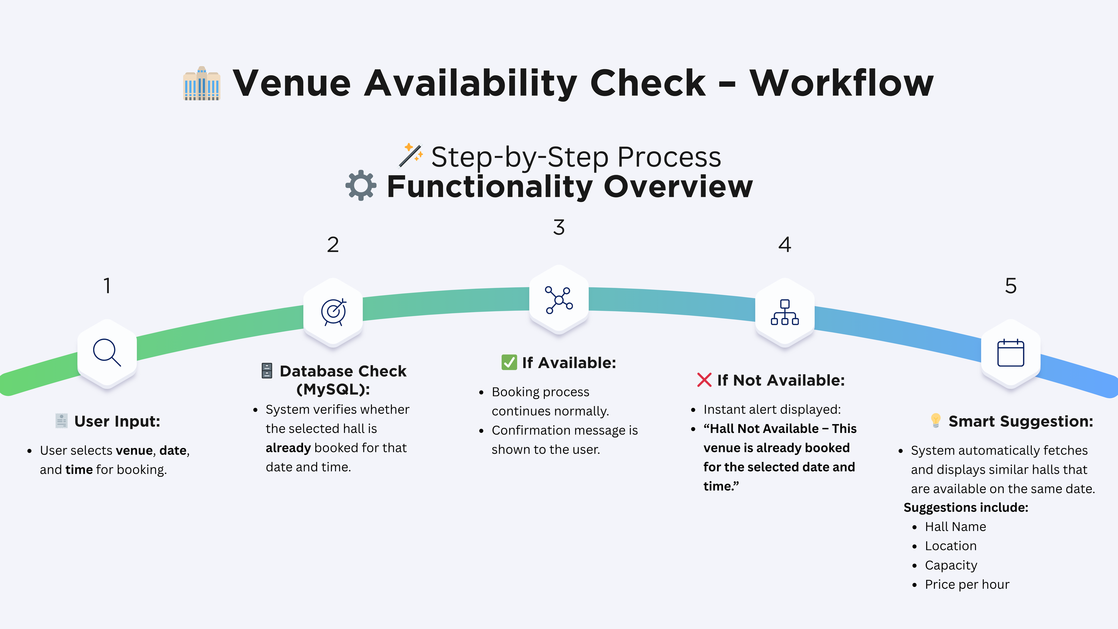
REGISTERED USER DASHBOARD (AFTER LOGIN)

Slide 10
ADMIN PANEL
Purpose: Provide complete control to admin to manage halls and monitor user activity.
Admin Features:
Add, edit, or delete event halls.
Monitor all hall bookings and see which user booked which hall.
Manage venue owners, categories, and site data.
View total statistics of users, halls, and bookings.
The user books a hall through the User Dashboard by selecting the hall, date, and providing necessary details.
Once the booking is confirmed, the booking details — including hall name, user information, and booking date — are automatically saved in the database.
These booking details are then displayed in real time on the Owner Dashboard under the “Bookings” section.
The hall owner can view all bookings made for their halls instantly, ensuring transparency and smooth communication between the user and owner.

Slide 11






FUTURE ENHANCEMENTS
Online payment gateway integration
Review and rating system for halls
Notification and reminder features
Users will be able to pay securely while booking halls.
Supports multiple payment options like UPI, cards, and wallets.
Users can share feedback and rate halls after events.
Helps improve quality and builds trust among new users.
Sends booking confirmations and event reminders via email or SMS.
Keeps users updated about their upcoming events.
Multi-language support for chatbot
Cake , Photographer, Planners, Attrie Booking Implimented Via Plateform
Chatbot will support multiple languages for wider reach.
Enhances user experience and accessibility for all regions.
✅ All these services are fully implemented and can be accessed through the user dashboard.

Slide 12

CONCLUSION
Smart Event Booking Platform makes event planning easy and efficient by combining AI, automation, and user-friendly design.
It provides a one-stop solution for booking venues and event services through a single platform.
Simplifies event booking with smart technology.
Offers AI-driven recommendations and chatbot support.
Connects users, planners, and admins in one system.
A step toward modern, automated event management.

Slide 13



